Slide 1
BLOCKCHAIN PÚBLICO vs PERMISSIONADO
PERCIVAL LUCENA, MSC. IBM RESEARCH https://www.linkedin.com/in/percivallucena https://twitter.com/plucena

Slide 2
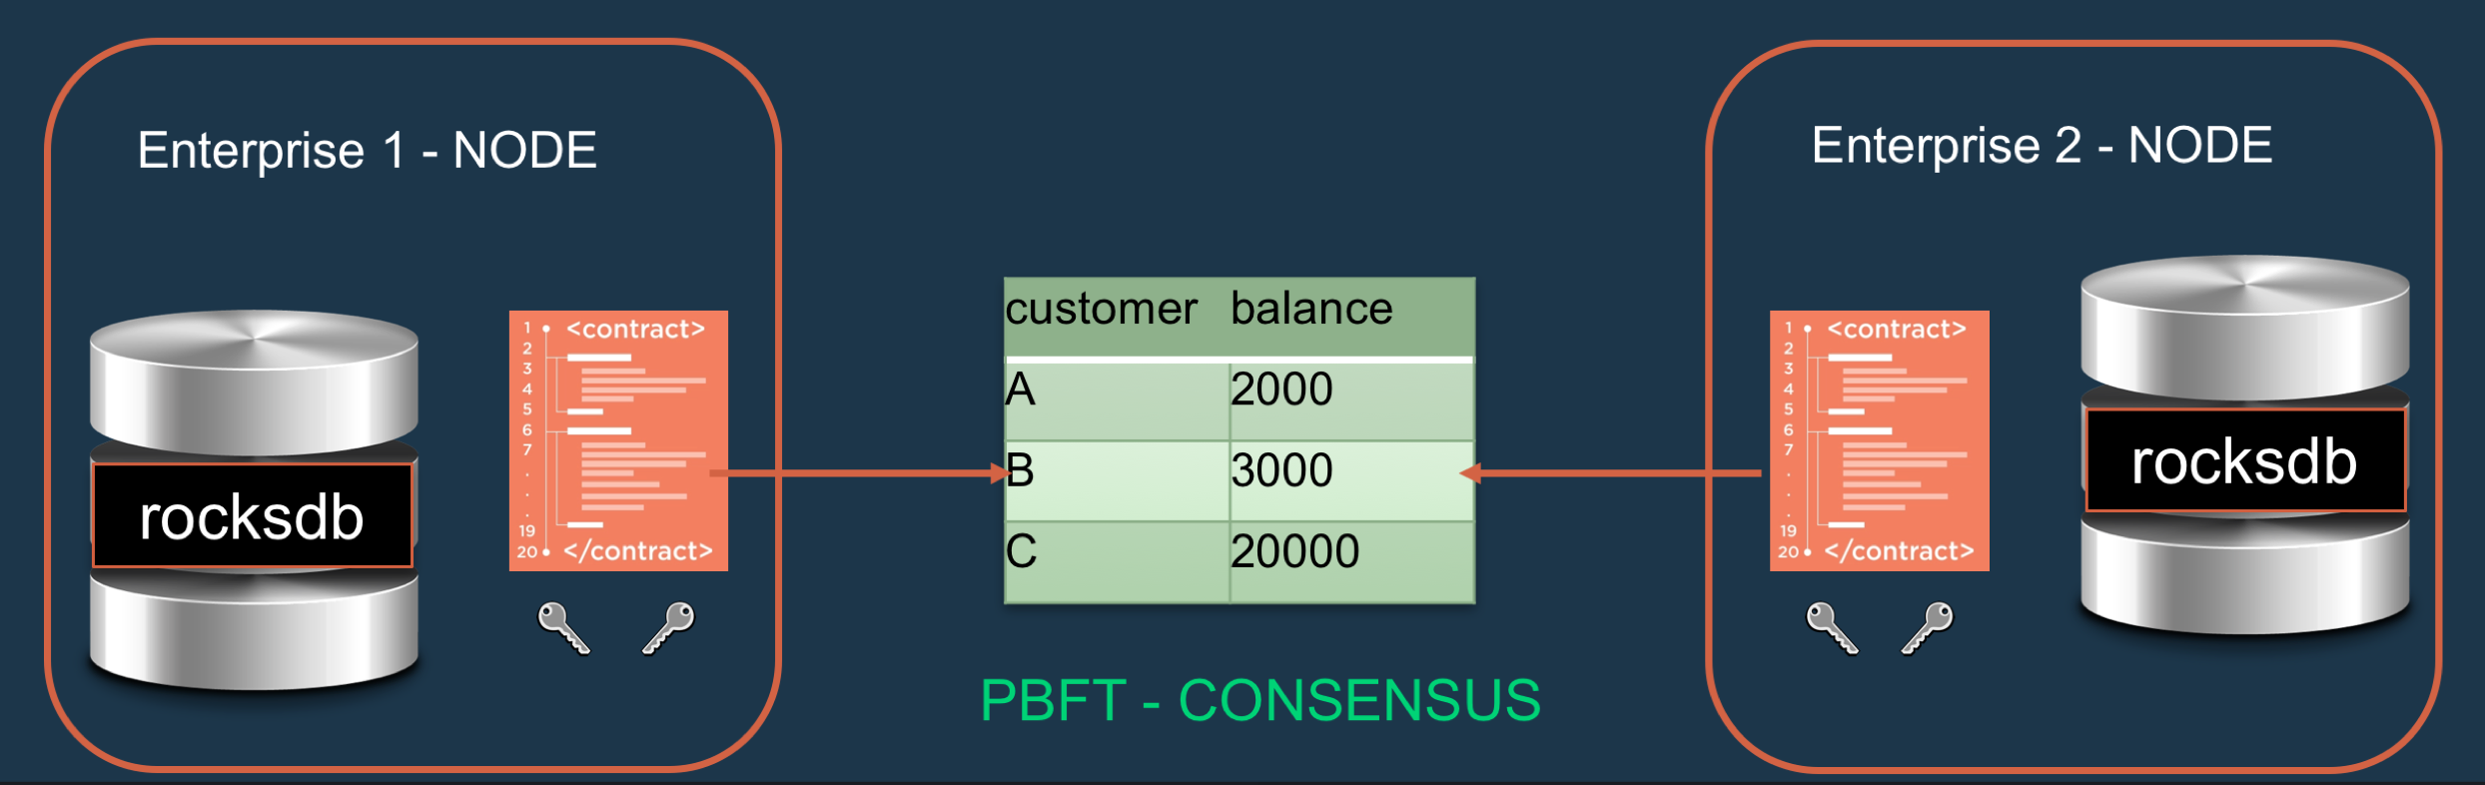
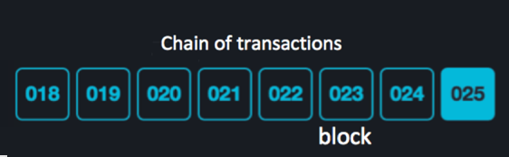

Blockchain – Uma cadeia IMUTÁVEL de blocos de transações
©2016 IBM Corporation

Slide 3
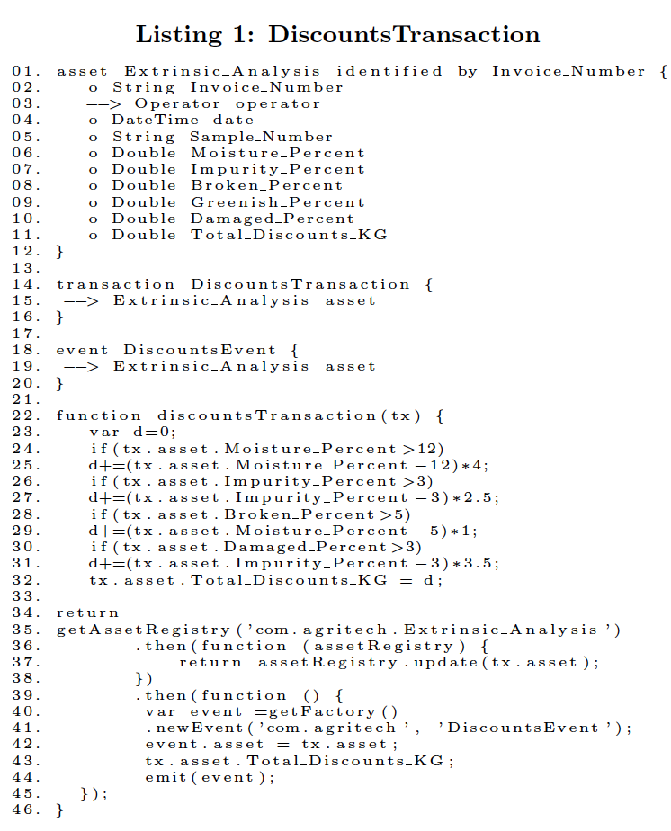
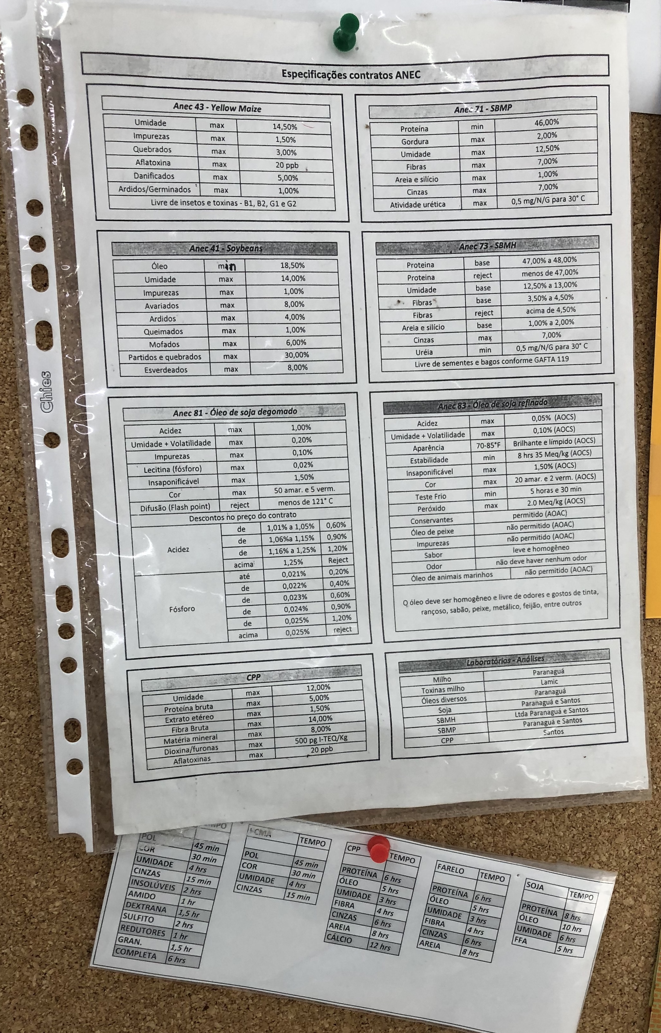
Smart Contract
©2016 IBM Corporation

Slide 4
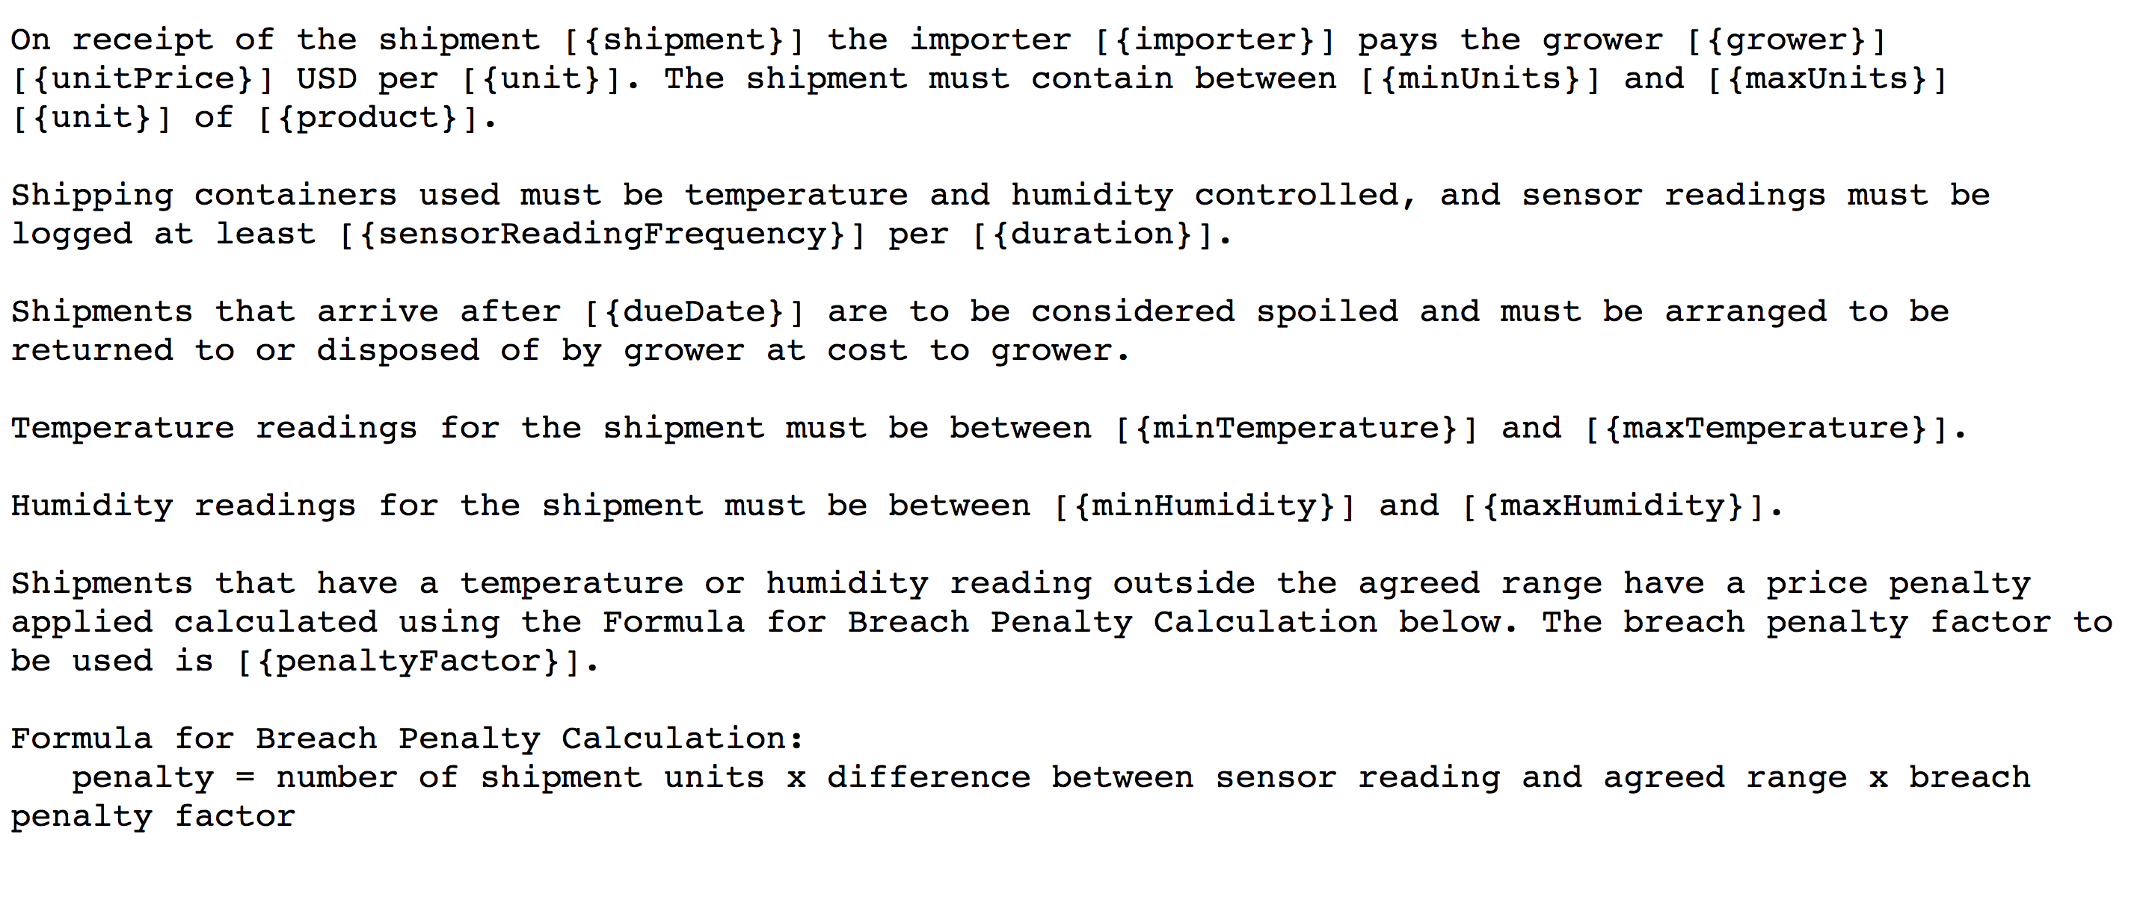
Smart Contract
©2016 IBM Corporation

Slide 5
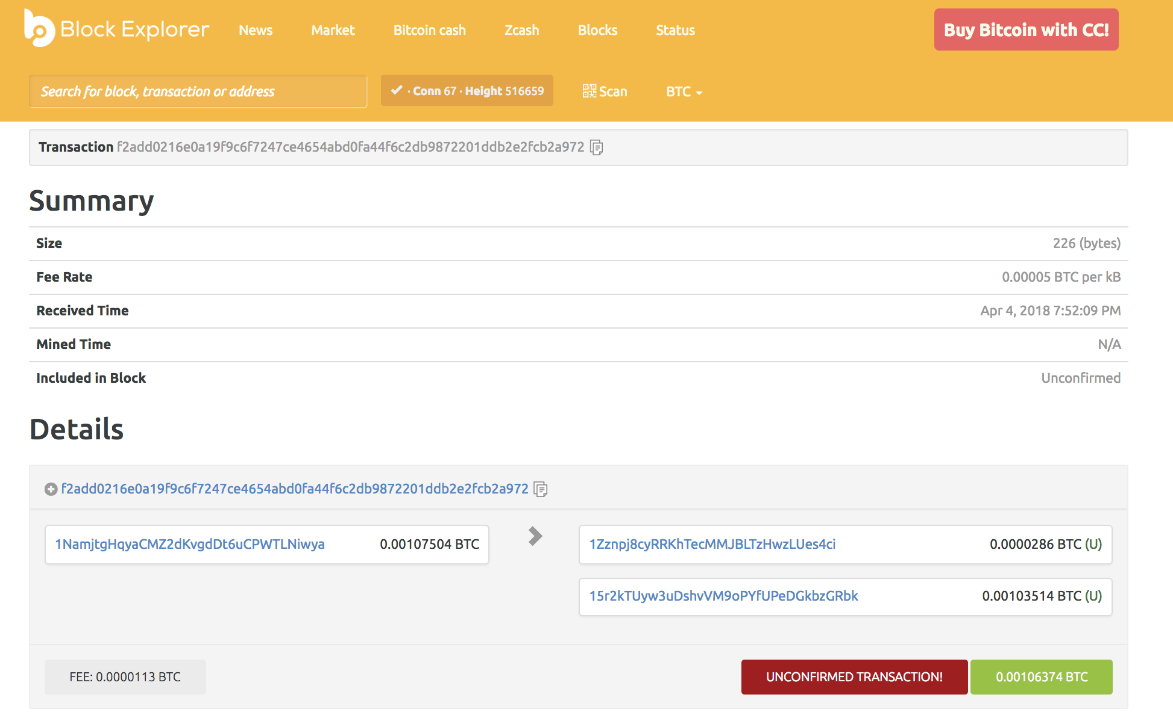
Blockchain Não Permissionado - Público

Slide 6
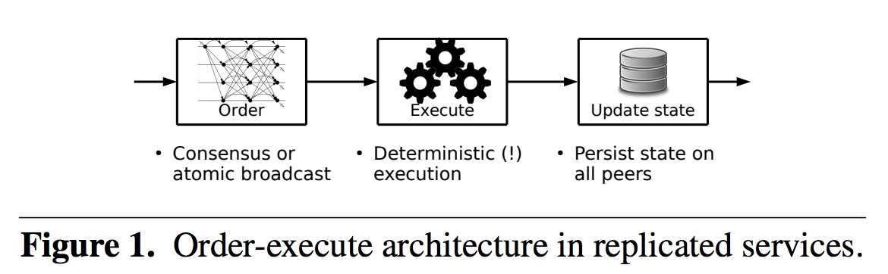
Consensus - Não Permissionado - Público
Traditional blockchain platforms, permissionless and permissioned ones, follow a sequential execution style, whereby transactions on smart contracts are typically executed after consensus or entwined with it and where all participants execute all contracts. This order-execute architecture (Figure 1) limits the scalability, requires sequential execution of transactions, and endorsement by all peers.

Slide 7
Consensus - Proof of work
Transactions to be processed
Transactions already validated (and in the chain)
Node
....
Process work to validate transactions
Retrieve pending transactions
Process work
Broadcast that work is completed
Write transaction into the blockchain if transaction is valid for majority of nodes
Node
Node
Node
...
Notes:
Proof of work is a consensus technique used in blockchain implementations to check which blocks can be recorded in the chain. Each node in the network needs to perform a work before telling the other nodes that the former has validated it (worked in the problem). A key aspect of Proof-of-Work is that it takes CPU effort to perform the work, but it is straightforward to validate that the work was done. If the majority of the nodes executed the work and they generated the same result, a consensus is achieved and the block is written in the chain.

Slide 8
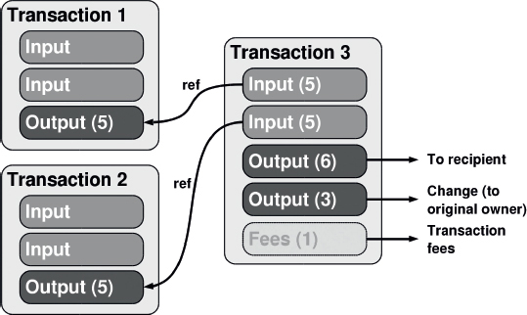
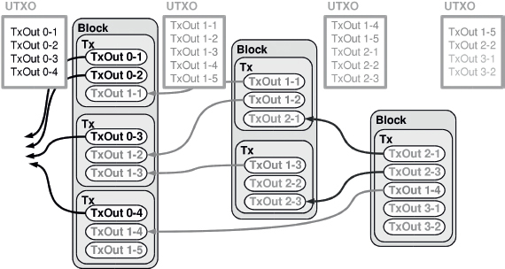
Consensus - Proof of work
Consensus
Notes:
Transactions são compostas de uma lista de entradas (TxIn) e uma lista de saidas (TxOut). Cada saida (TxOut) possuí : um valor e endereço bitcoin do recipiente O endereço é derivado da chave pública do recipiente da transação. Apenas o dono da chave primária correspondente aos fundos de entrada pode assinar a transação usando a chave privada.
A transação é então enviada para algum nó da rede que verificarará no UXTO se a transação é valida e avisará os outros nós da rede. A transação é a adicionada a um novo bloco de transação (blockchain) quando algum miner descobre o noonce (ocorre cada 10 minutos, a dificuldade da rede aumenta para manter 10 min)

Slide 9
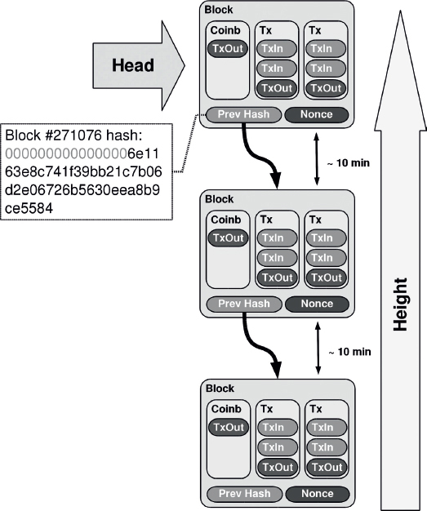
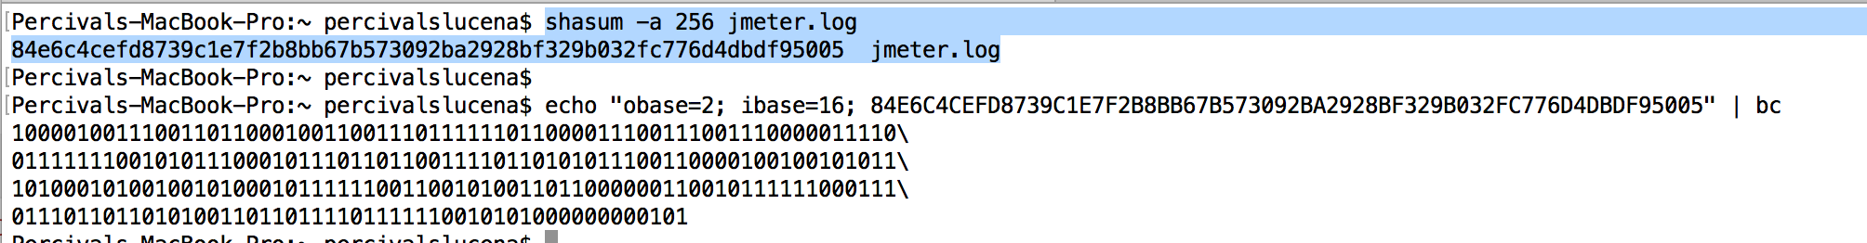
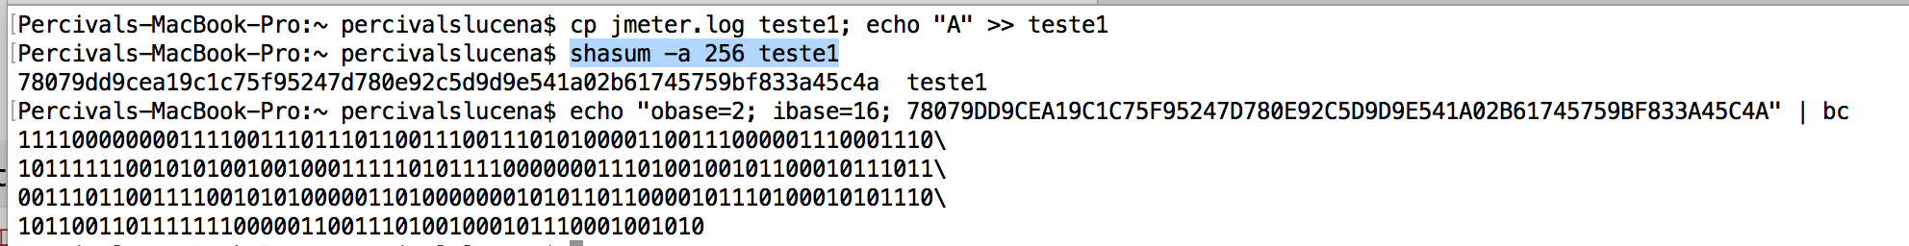
Nonce - SHA
Consensus
Notes:
Blockchain é uma lista ligada de blocos de transações que vão desde as últimas até o começo das transações (Genesis) de Satoshi até hoje Cada bloco pode ter no máximo 1MB. Cada transação ocupa 250 bytes.
4000 transações a cada minuto
400 transações por minuto Cada bloco contem coinbase que inclui as taxas de cada transação e o prêmio para o miner
Até Maio de 2016 temos 409.912 blocos
Tamanho do BD é > 80GB

Slide 10



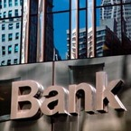








Rede de Negócios sem Blockchain
Participant B’s records
Participant A’s records
Bank records
Insurer records
Regulator records
Auditor records
\
Notes:
This is the “BEFORE” picture representing the “status quo” for business networks.
Each participant keeps their own ledger(s) which are updated to represent business transactions as they occur.
This is EXPENSIVE due to duplication of effort and intermediaries adding margin for services.
It is clearly INEFFICIENT, as the business conditions – the contract – is duplicated by every network participant
It is also VULNERABLE because if a central system (e.g. Bank) is compromised due to an incidents this affects the whole business network. Incidents can include fraud, cyber attack or a simple mistake.

Slide 11

Blockchain Permissionado
Participant B’s records
Participant A’s records
Bank records
Blockchain
Insurer records
Regulator records
Auditor records
… with consensus, provenance, immutability and finality
Notes:
The novel Blockchain architecture give participants the ability to share a ledger which is updated every time a transaction occurs through peer to peer replication.
Cryptography is used to ensure that network participants see only the parts of the ledger that are relevant to them, and that transactions are secure, authenticated and verifiable.
Blockchain also allows the contract for asset transfer to be embedded in the transaction database determining the conditions under which the transaction can occur.
Network participants agree how transactions are verified through consensus or similar mechanisms. Government oversight, compliance & audit can be part of the same network.
Participants SAME AS BEFORE – this is not a disintermediation play
CONSENSUS– means all participants agree that a transaction is valid
PROVENANCE– means participants know where the asset came from and how it’s ownership has changed over time
IMMUTABILITY– means no participant can tamper with a transaction once it’s agreed. If a transaction was in error then a NEW transaction must be used to reverse the error, with both visible
FINALITY– means that there is ONE place to determine the ownership of an asset or completion of a transaction. This is the role of the SHARED LEDGER.

Slide 12
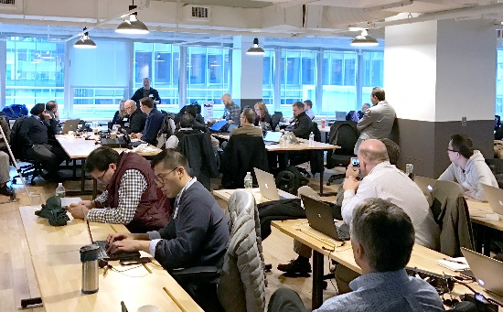
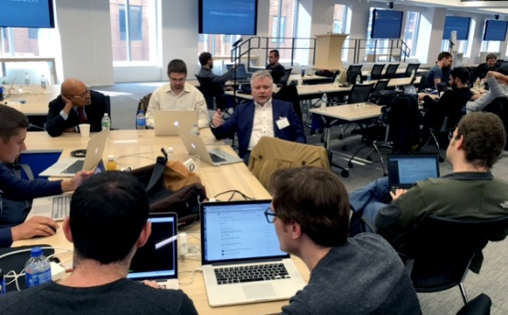
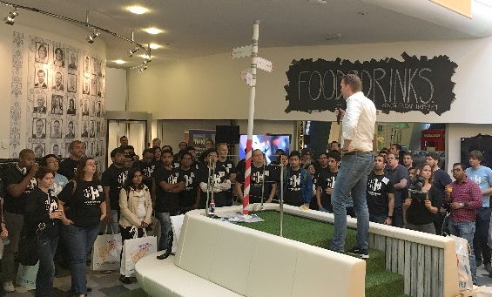
Blockchain – Hyperledger – Linux Foundation
The Hyperledger project is an open source collaborative effort created to advance cross-industry blockchain technologies.
5
PROJECTS
110+
MEMBERS
15
PREMIER MEMBERS
120+
CONTRIBUTORS
4.5K+
ACCESS TO THE CODE
5K+
HYPERLEDGER PROJECT SLACK MEMBERS

Slide 13
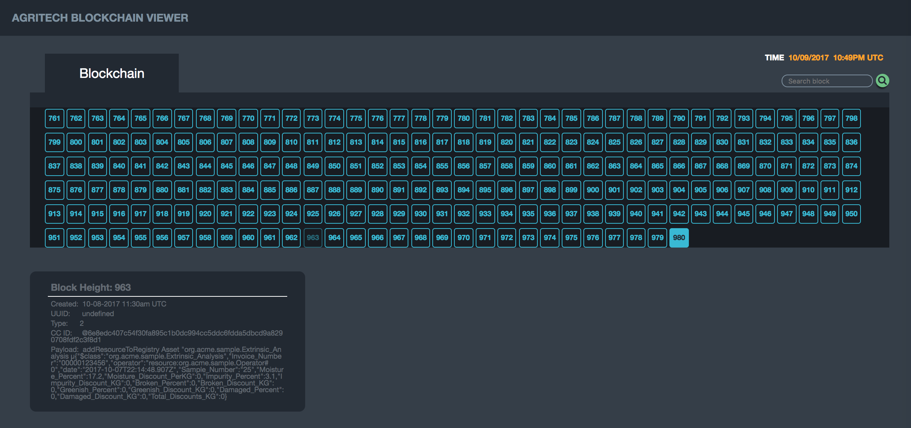
Blockchain – Hyperledger – Linux Foundation

Slide 14
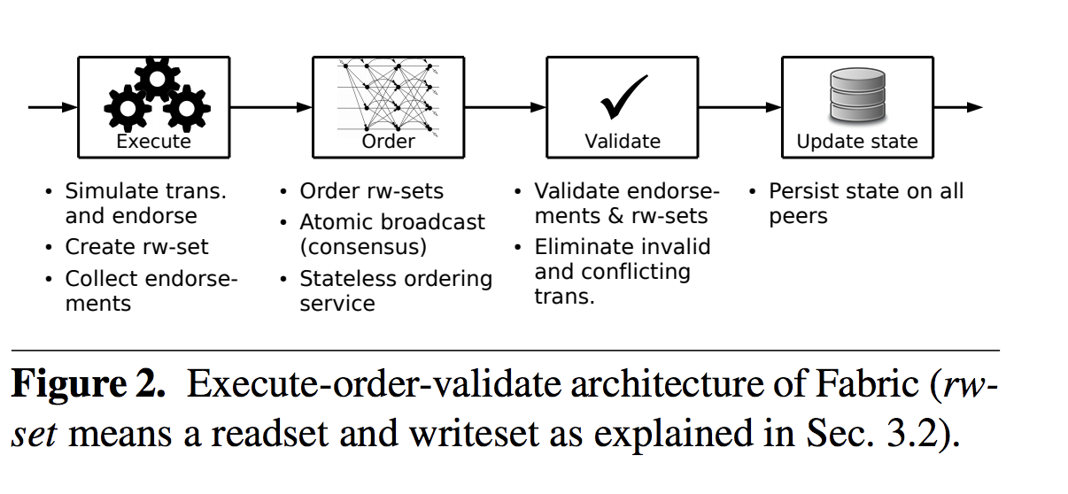
Blockchain – Hyperledger – Modelo Consensus
Endorse
Order
Validate

Slide 15
Smart Contract Execution - Endorsement
Application proposes transaction
Endorsement policy:
“E_{0,} E₁ and E₂ must sign”
(P₃, P₄ are not part of the policy)
Client application submits a transaction proposal for Smart Contract A. It must target the required peers {E₀, E₁, E₂}
E₀
P₃
P₄
A
B
A
D
SDK
E₁
Client
Application
O
O
A
B
E₂
P
O
O
Key:
A
Endorser |  |  | Ledger
Committing Peer |  |  | Application
Ordering Node
Smart Contract (Chaincode) |  |  | Endorsement Policy
B
Ordering-Service
Hyperledger Fabric Network
Notes:
Overview of sample transaction (slides 1-7):
Separation of simulation (chaincode execution) and block validation/commit
Invocation of chaincode operation (business transaction) carried out in 3 phases:
Chaincode operation execution simulated on ‘endorsing’ peers.
Parallel simulation enabled on endorsers for improved concurrency and scalability since the simulation does not update the blockchain state
Simulation determines business tran-proposal: readset/writeset, and broadcasts this to the ordering service.
Tran-proposal is then ordered w.r.t. other tran-proposals and broadcast to commiting peers (includes endorsing peers).
Commiting peers validate tran-proposal.readset has not been modified since simulation, and applies the tran-proposal.writeset ‘atomically’.

Slide 16
Smart Contract Execution - Ordering
Responses submitted for ordering
Application submits responses as a transaction to be ordered.
Ordering happens across the fabric in parallel with transactions submitted by other applications
E₀
P₃
P₄
A
B
A
D
SDK
E₁
Client
Application
O
O
A
B
E₂
P
O
O
Key:
A
Endorser |  |  | Ledger
Committing Peer |  |  | Application
Ordering Node
Smart Contract (Chaincode) |  |  | Endorsement Policy
B
Ordering-Service
Hyperledger Fabric Network
(other applications)
Notes:
Overview of sample transaction (slides 1-7):
Separation of simulation (chaincode execution) and block validation/commit
Invocation of chaincode operation (business transaction) carried out in 3 phases:
Chaincode operation execution simulated on ‘endorsing’ peers.
Parallel simulation enabled on endorsers for improved concurrency and scalability since the simulation does not update the blockchain state
Simulation determines business tran-proposal: readset/writeset, and broadcasts this to the ordering service.
Tran-proposal is then ordered w.r.t. other tran-proposals and broadcast to commiting peers (includes endorsing peers).
Commiting peers validate tran-proposal.readset has not been modified since simulation, and applies the tran-proposal.writeset ‘atomically’.

Slide 17
Smart Contract Execution - Validate
Orderer delivers to committing peers
Ordering service collects transactions into proposed blocks for distribution to committing peers. Peers can deliver to other peers in a hierarchy (not shown)
Kafka (Crash fault tolerance)
E₀
P₃
P₄
A
B
A
D
E₁
*
Client
Application
SDK
O
O
A
B
E₂
P
O
O
Key:
A
Endorser |  |  | Ledger
Committing Peer |  |  | Application
Ordering Node
Smart Contract (Chaincode) |  |  | Endorsement Policy
B
Ordering-Service
Hyperledger Fabric Network
Notes:
Overview of sample transaction (slides 1-7):
Separation of simulation (chaincode execution) and block validation/commit
Invocation of chaincode operation (business transaction) carried out in 3 phases:
Chaincode operation execution simulated on ‘endorsing’ peers.
Parallel simulation enabled on endorsers for improved concurrency and scalability since the simulation does not update the blockchain state
Simulation determines business tran-proposal: readset/writeset, and broadcasts this to the ordering service.
Tran-proposal is then ordered w.r.t. other tran-proposals and broadcast to commiting peers (includes endorsing peers).
Commiting peers validate tran-proposal.readset has not been modified since simulation, and applies the tran-proposal.writeset ‘atomically’.

Slide 18
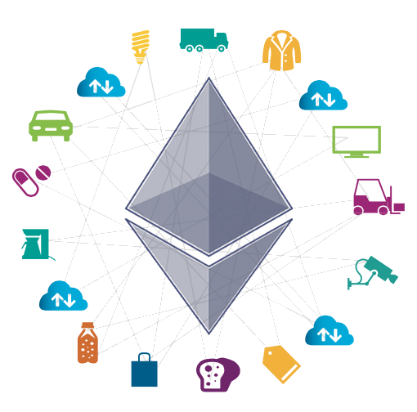
Blockchain – Contexto da Plataforma
1995- 2005 – Internet da Informação
serviços: ecommerce, ebanking
digitalização: email, ebooks, emusic, emovies
2005 - 2015 – Internet Social
redes sociais – troca de informação P2P bloggers, youtubers
economia compartilhada (uber, airbnb, crowdfunding, crowdsourcing)
2015 – Internet do valor
Currency Tokens
Equity Tokens – ICO vs IPO – SEC Ex:
Utility Tokens - subscription model: wine, beer, books
Permissioned Blockchains (Food Safety, Global Trade, Xborder Payments, Agrichain)
©2016 IBM Corporation

Slide 19
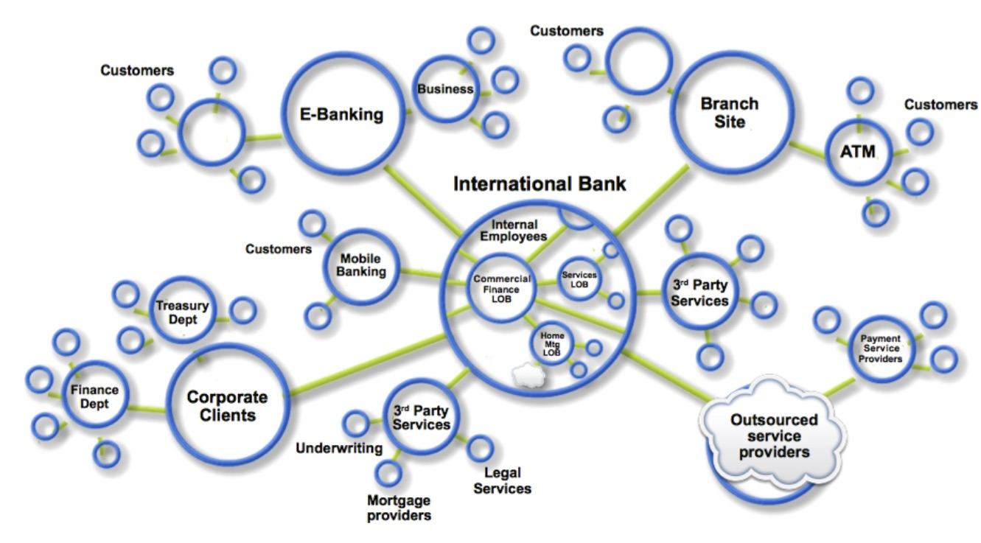
Business Networks Markets
Redes de negócio aumentam conectividade
Exs Participantes: clientes, fornecedores, bancos, parceiros
Aderência a legislação de vários países
Valor é gerado, a partir do fluxo de mercadorias e serviços dentro da rede de negócio através de transações e smart contracts.
Associações e Consórcios são necessários para estabelecer a rede. Processo de governança, regulamentação da rede
©2016 IBM Corporation

Slide 20
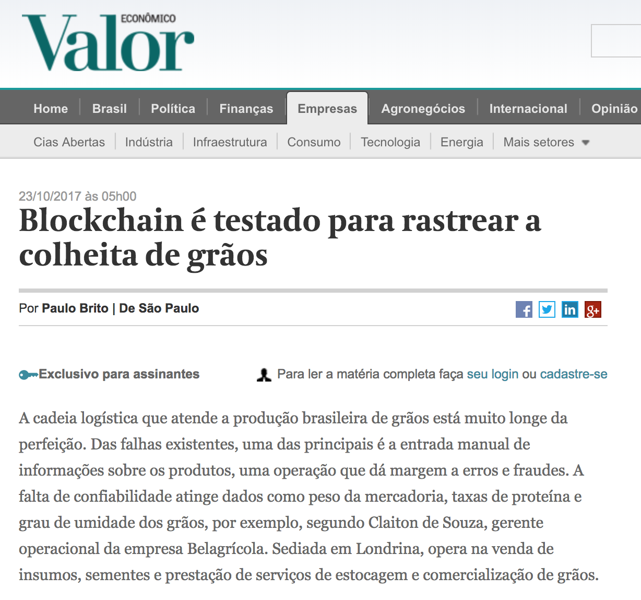
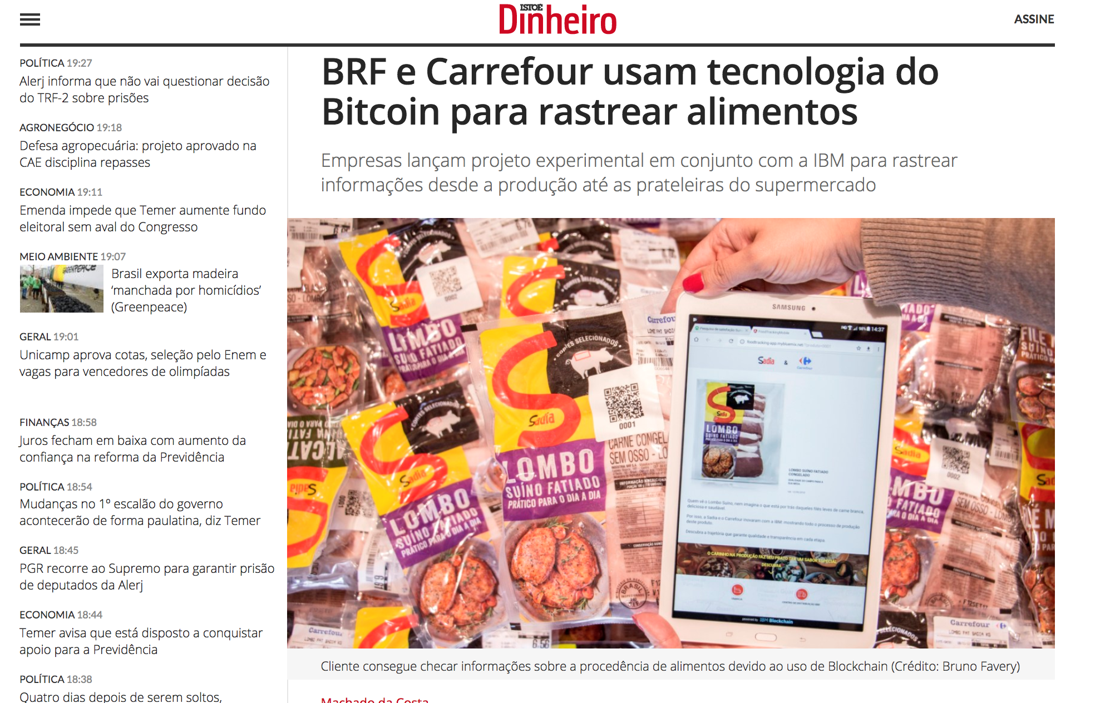
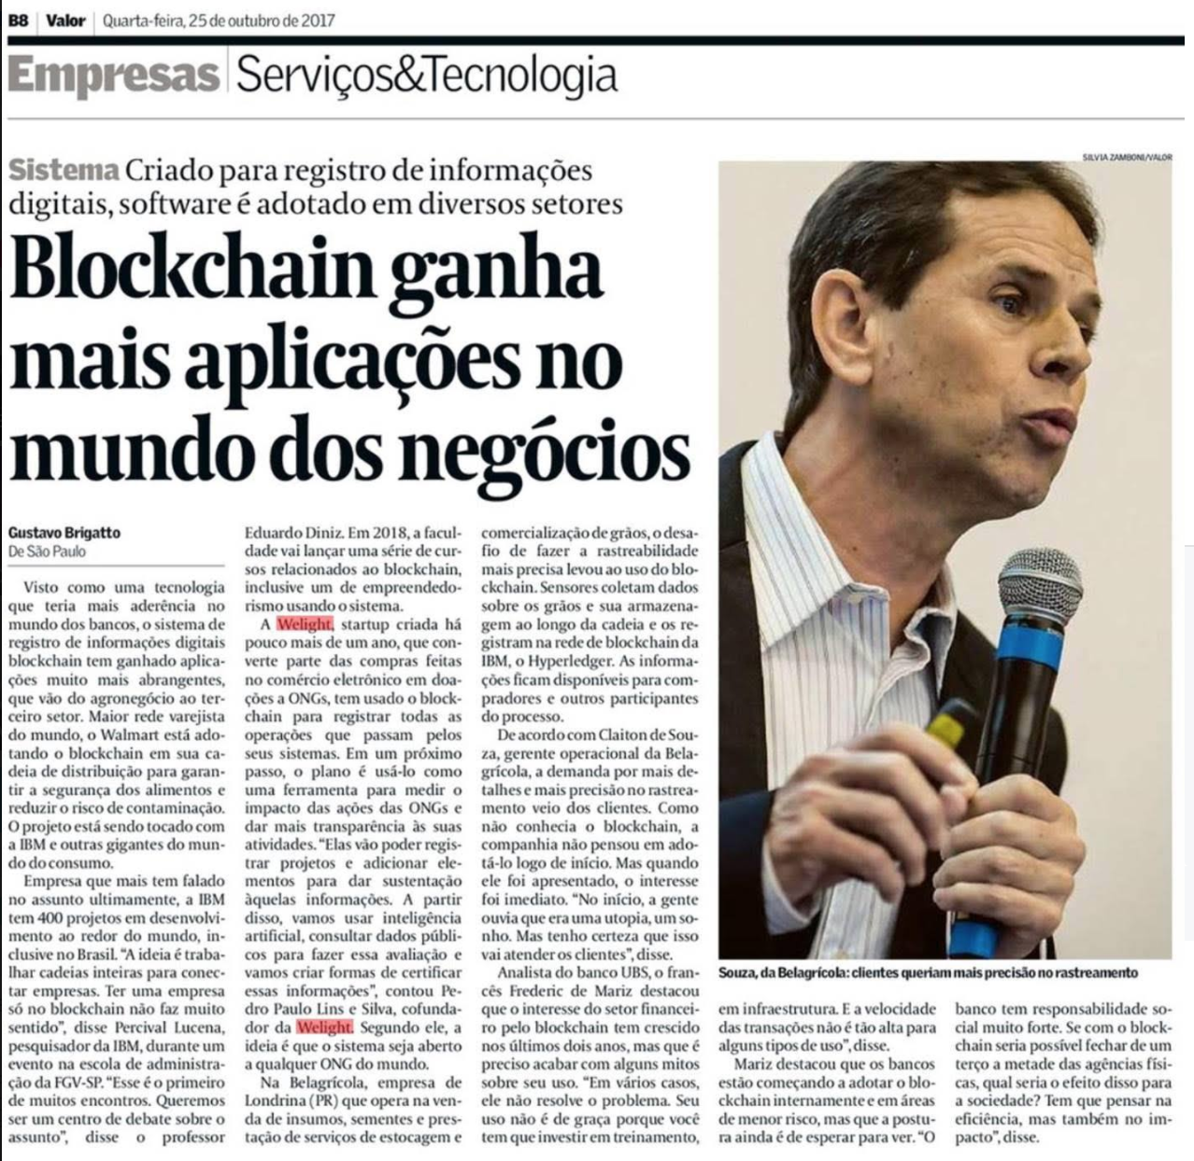
Business Networks BR – AgriChain, FoodSafety-BR
©2016 IBM Corporation

Slide 21
Agritech Business Network
Fontes
Contrato de Venda
Romaneio Entrada
Contrato de Venda
Royalties Sementes
Contrato de Bart
Romaneio Sada
Blockchain
Contrato Venda
Transporte
Cooperativa
Trading
Produtor de Sementes
Transporte
Porto
©2016 IBM Corporation
12

Slide 22
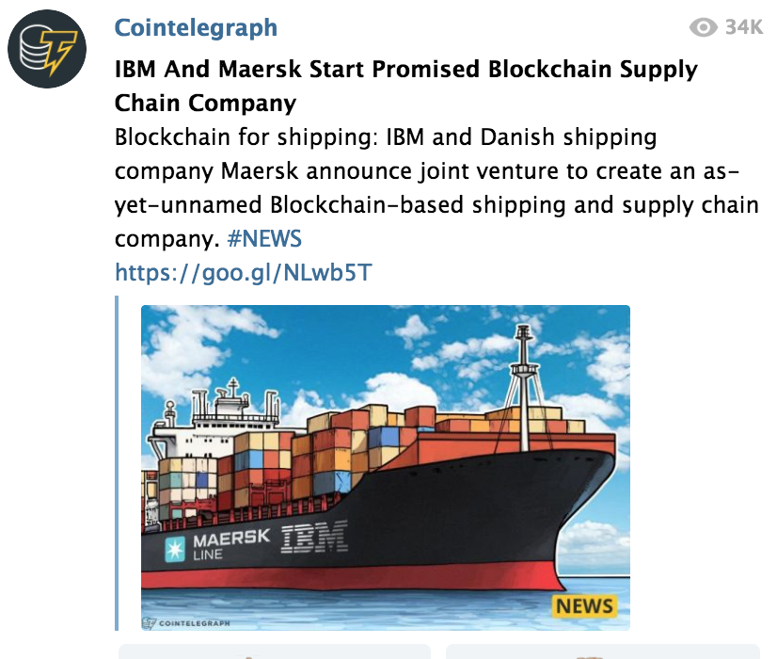
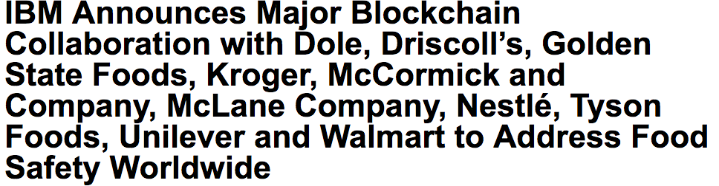
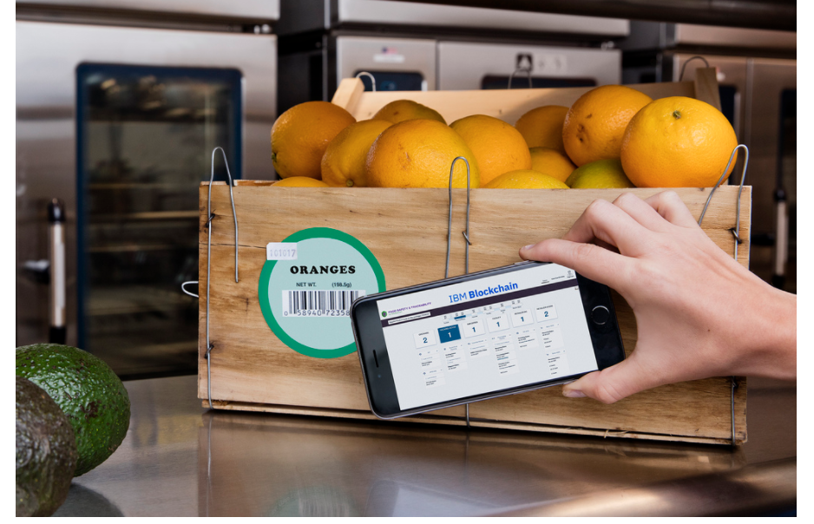
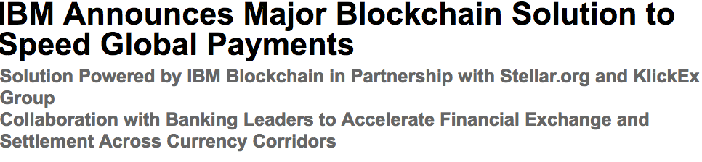
Business Networks– FoodSafety, GTD, Intl Remitences
©2016 IBM Corporation

Slide 23

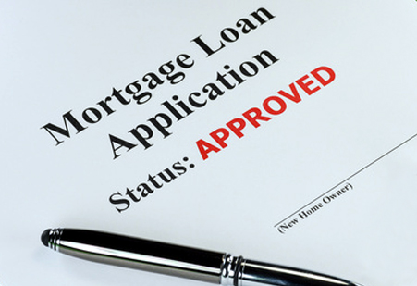

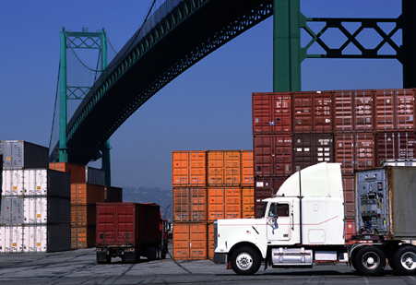
Business Networks – Use Cases
Agricultura | Governo | Finanças | Seguros | Indústria
Rastreamento de Grãos Crédito Rural Barter | Identidade do cidadão Prontuários médicos | Cadeia de Fornecimento Programas de Fidelidade Logística | Processamento de Sinistros Controle de riscos Histórico de uso de ativos | Cadeia de fornecimento Recall de Produtos Rastreabilidade de Origem (Food Safety)
©2016 IBM Corporation

Slide 24
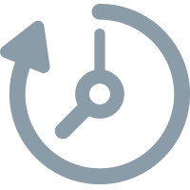



Blockchain – Business Value
Reduz Tempo | Remove Custos | Mitiga Riscos | Novos Modelos de Negócios
Ativa a reconciliação As transações comerciais podem ser realizadas em tempo quase real | Desintermediação As redes de negócios elimina intermediários e escala facilmente | Conformidade e Fraude Transações comerciais tornam-se imutáveis, verificáveis e auditáveis | Inovação Redes de negócios remodeladas e redes de lucro são redefinidas

Slide 25
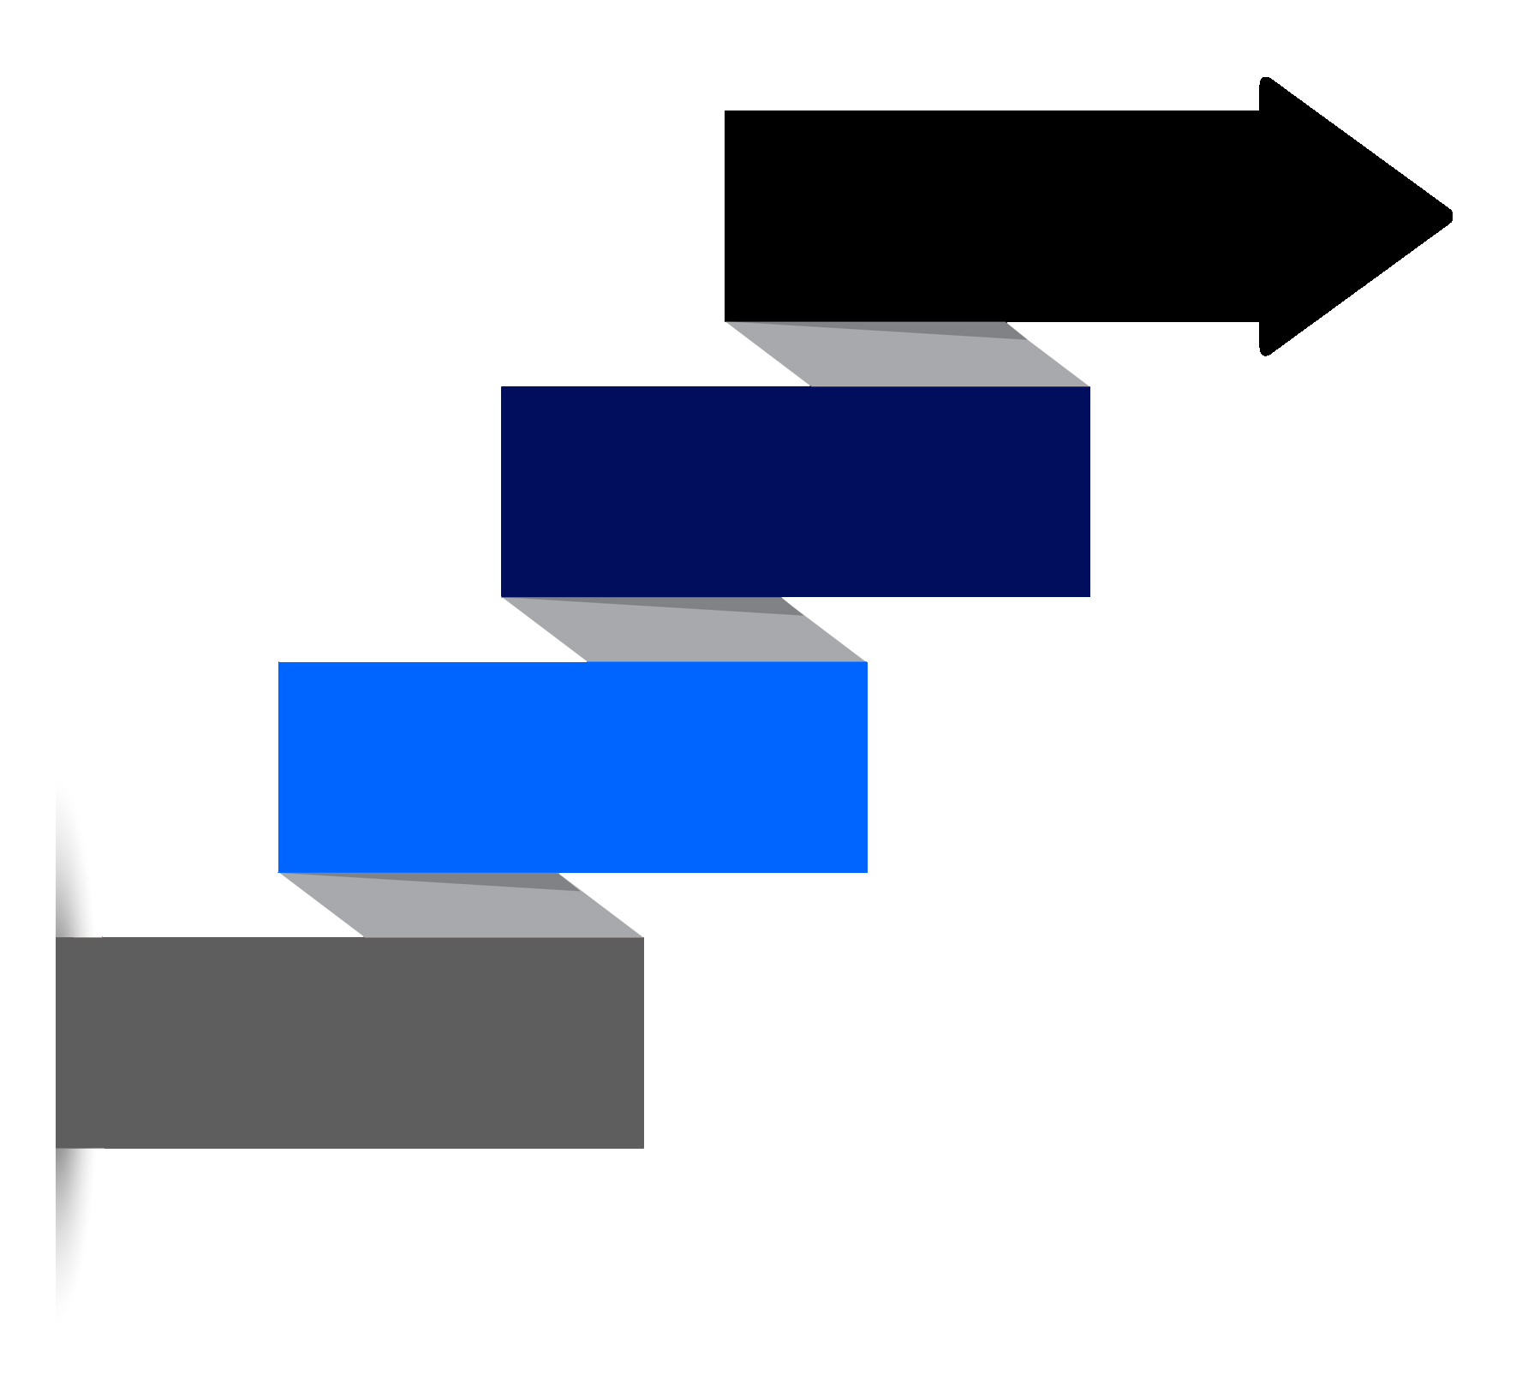
Patterns for customer adoption
HIGH VALUE MARKET
Transfer of high value assets
Between many participants in a market
Regulatory timeframes
ASSET EXCHANGE
Sharing of assets (voting, dividend notification)
Assets are intangible
Provenance & finality are key
CONSORTIUM SHARED LEDGER
Created by a small set of participants
Share key reference data
Consolidated, consistent real-time view
COMPLIANCE LEDGER
Real-time view of compliance, audit & risk data
Provenance, immutability & finality are key
Transparent access to auditor & regulator
Notes:
Blockchain use-cases tend to fall into one of these four categories.
The categories towards the bottom of the chart tend to be easier to implement because they have fewer participants to influence, or require less regulatory involvement. This makes them more suited to first projects.
Use-cases in the categories towards the top of the chart may take longer to come to fruition, but are highly valuable/transformative.

Slide 26



Key players for blockchain adoption
Regulator | Industry Group | Market Maker
An organization who enforces the rules of play Regulators are keen to support Blockchain based innovations Concern is systemic risk – new technology, distributed data, security | Often funded by members of a business network Provide technical advice on industry trends Encourages best practice by making recommendations to members | In financial markets, takes buy-side and sell-side to provide liquidity More generally, the organization who innovates - Creates a new good or service, and business process (likely) - Creates a new business process for an existing good or service
Notes:
Blockchain use-cases tend to require the influence of one or more external stakeholders, which are described here.
An example of a non-financial market maker include Apple, if for example you wanted to create a secondary market for music licenses.

